Slide 1
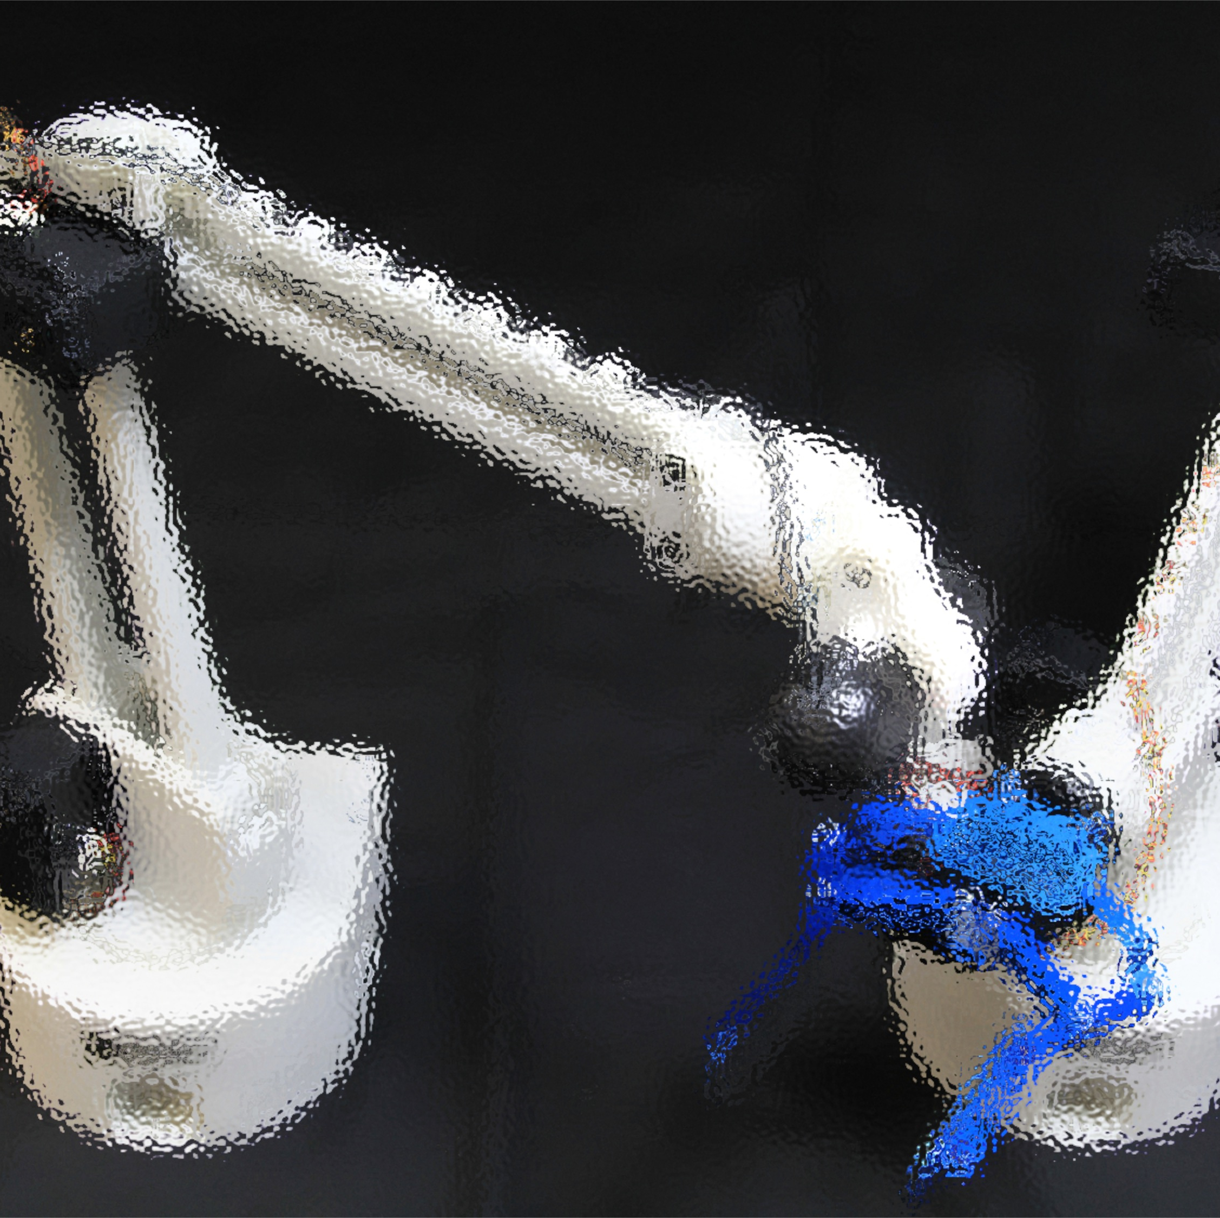
-Praktikum-
Cognitive Robots
Dr. Claus Lenz
Robotics and Embedded Systems
Department of Informatics
Technische Universität München
http://www6.in.tum.de/Main/TeachingWs2014LCCognitiveRobotics
10.04.2014

Slide 2
Object following
Separating / Sorting robot
Tattoo artist / writer robot
Games
Tetris

Slide 3
1) Object following
Show object to Cambot
Cambot should follow object
Gripperbot will also follow object based on Cambot data
If reachable, Gripperbot will “bite” and fetch it
Gripperbot puts it to a specific place

Slide 4
2) Separating robot
The hand with the camera analyzes the trash and categorizes the trash based on the perceived material
the robot hand sorts the trash based on the categorization
perhaps build some sort of shelf for the trash (because of the robot hand limitations)
Alternative
  1. the camera search and identify the color and location of each object and also the location of the mechanical hand.
  2. the camera send the location to the mechanical hand and the hand grasp corresponding objects and stack them up.
  As there are no sensors in the mechanical hand which can detect whether the hand grasp the object correctly, the camera will monitor the process.

Slide 5
6) Sorter
The workspace should have some blocks with numbers, colors, and letters, and a kind of shelf,
the user indicates through a microphone or through gesture recognition how the blocks must be sorter, e.g. by color,
and the hand must sort the blocks accordingly.

Slide 6
3) Tattoo artist / writer robot
The Kinect camera creates a 3D-model of the object (head, hand, leg, etc.)
The robot hand draws a tattoo on the surface with a marker pen
Alternatives:
  While a person writes, the eye has either to follow the movement of the writer, or to recognize the symbols, then the hand must write that symbols.
  The idea is that the eye recognizes the Mute-Sign Language symbols and the hand must achieves different tasks like open gripper, close gripper, carry object, sort objects, etc. or write down the words

Slide 7
4) Games
Chess
order dice
  according to the number on the top surface of the dice. The dice are lying at random places, and the grabber has to pick them and place them in a line, with the number on their top surface being ordered.
  The task could be complicated by giving verbal commands (e.g. ascending, descending, only dice with even or uneven number, etc.).
TIC TAC TOE:
  Field 3x3; cambot follows game, gripperbot has a pen
4 wins

Slide 8
5) Tetris
On an area next to the gripper-arm, tetris-objects are being placed by a human one-by-one.
The robot grips each object and tries to put them on a plank in front of it.
The camera is identifying the type of object and finds a place for it.
Alternatively while the gripper holds the object, a user could give instructions with gestures to the camera on how to rotate the object, which would direct them to the gripper.
(Note: gripper has no rotation → I suggest to rotate the objects by the user, the system will find the optimal placement then)

Slide 9
Chosen Application
Sorting

Slide 10
Gripper Bot Tasks / Modules I
Task 1 - Communication
  Positions of the objects
  → in world coordinates (coordinate transformation)
  Type of objects
  “World Model”
  → Collection of relevant information
  → update world model
Task 2 – Sorting
  Sorting strategy
  Graps objects (based on strategy)
  Sort them

Slide 11
Gripper Bot Tasks / Modules II
Required
  Know where to put objects
  Decide the order of sorting / Strategy
  → Order
  Moving
  Gripping (also change/ adapt design of gripper)
  Calibration / Grasping strategy
  Error handling / Recovery
Team:
  Wang Ke
  Fungja Hui

Slide 12
Common Things
The same coordinate system for both robots
Moving robots to specific positions
Collisions between robots
→ start with “good” timing; later parallel robot action might be possible with active collision avoidance
Timing
→ Coordinating Module
Interface to the whole system
→ command line / GUI / Speech Recognition/ Visualization (?)
Task: Calibration of the robots in the world
Define the objects:
  Start with simple (easy to grasp and recognize) objects
  Different colors: RED; GREEN; BLUE;
  Different shapes: CUBE; CYLINDER; SPHERE;

Slide 13
CamBot Tasks I
Task 1 - Recogniton of objects
  “survey the workspace”
  → moving
  → search for dead spots
  Type of objects (Classification)
  Position of objects (Pose estimation)
Task 2 - Check if grasping worked
  Move to gripper and “look” if object is in hand

Slide 14
CamBot Tasks II
Required:
  Camera stream
  Coordinates
  Calibration of camera & camera to robot (hand-eye calibration)
  Models of our objects
  Algorithm to make the classification
  Error handling / recovery
Team:

