Slide 1
The schematic of the wire connection in the module
Long Cheng

Slide 2
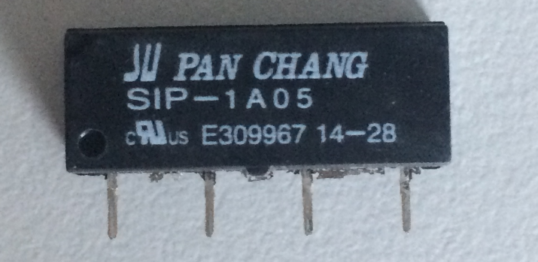
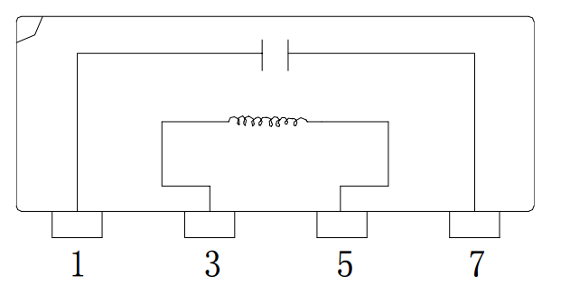
Switch
Each module has a switch on the output of the battery.
Manually control the switch?
The switch should be controlled by the previous module, and we only control the switch in the first module.
Relay
V₃₅ > 5V, pin 1 and pin7 are connected

Slide 3
Power on the snake robot
Connect the master board or the board at first module to the computer.
The board controls its relay to switch on.
Then, the switch-output pins from the master module or the first module are connected to its battery. The voltage is about 8V.
The switch-output pins are connected the to pin3 and pin 5 of the relay in next module.
The relay in next module is switched on.
Similar to the step 2-5, all the modules are powered on.

Slide 4
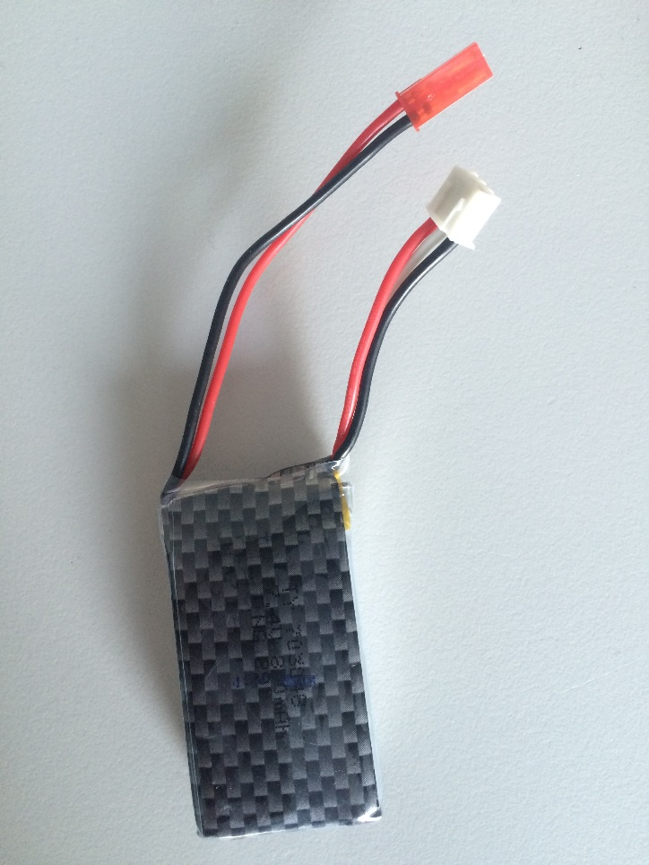
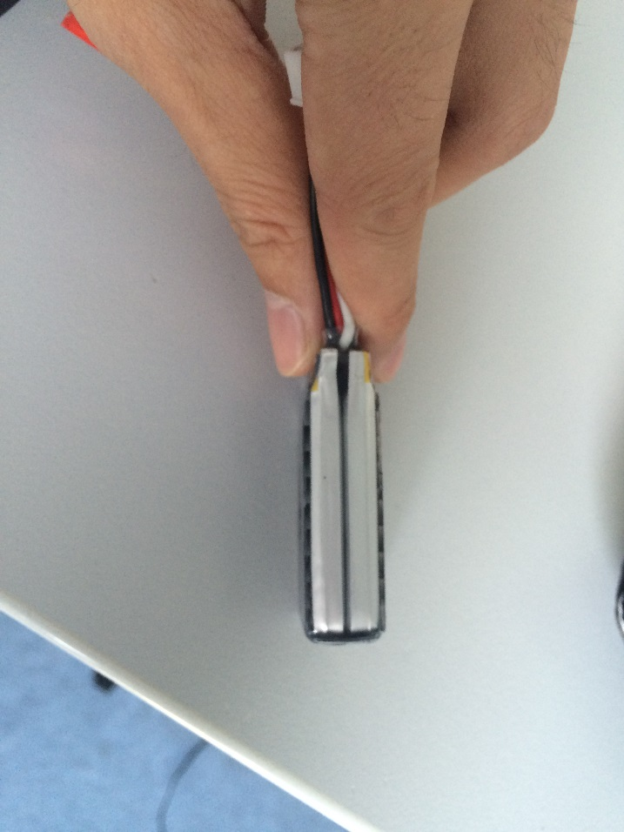
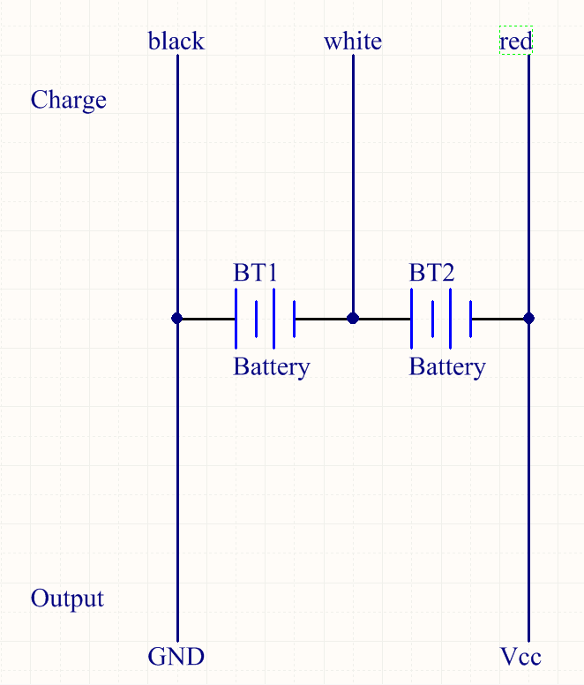
The battery
output
charge

Slide 5
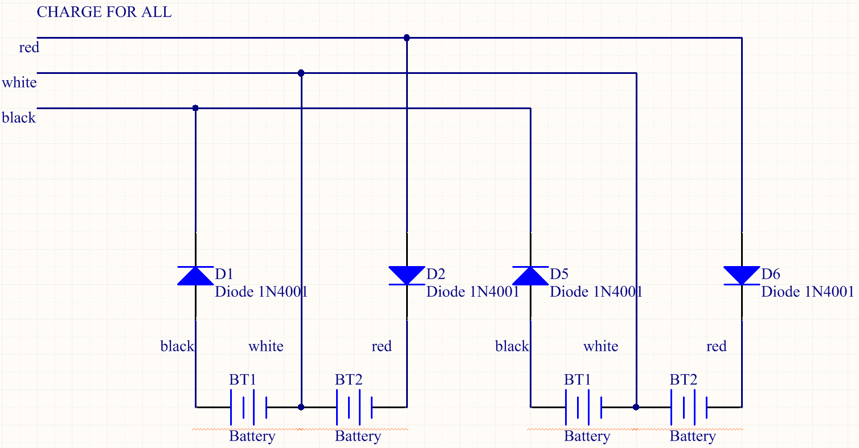
The battery

Slide 6
The PCB board
Switch
Battery
  Output
  Charge
Arduino Nano connection to servo, angle sensor, bus.

Slide 7
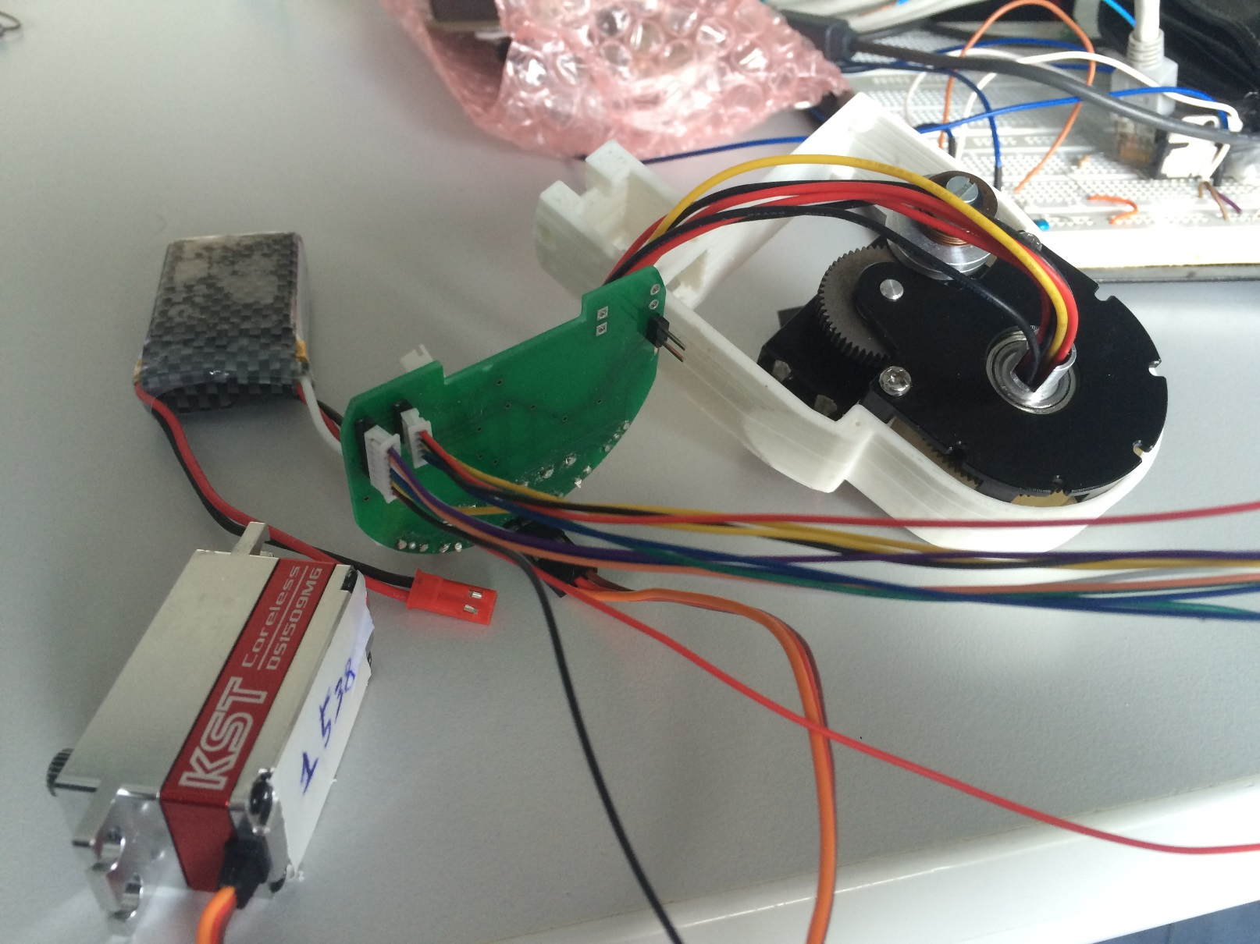
The PCB board
Angle sensor
Nano

Slide 8
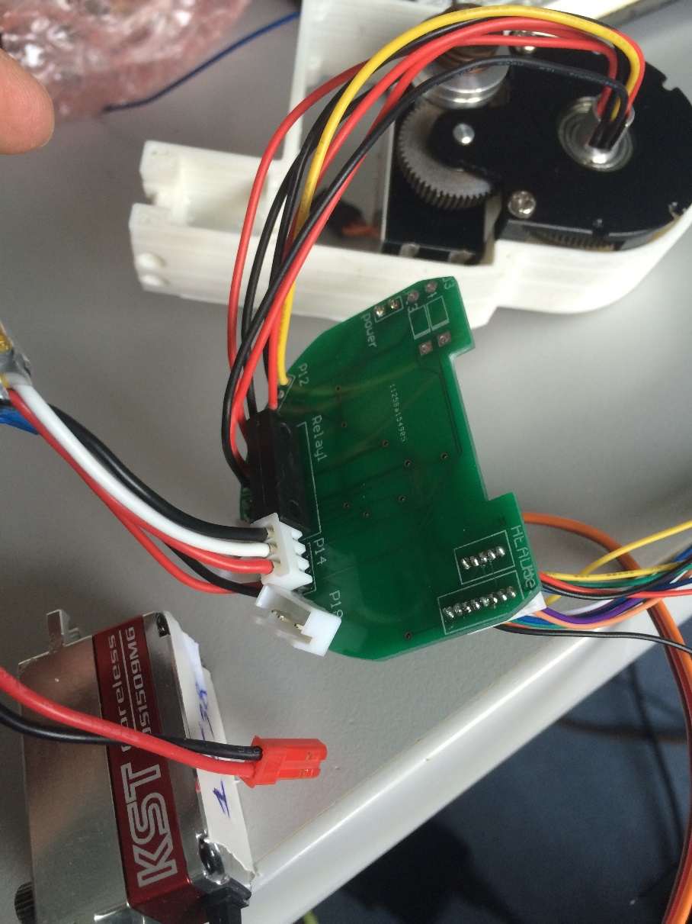
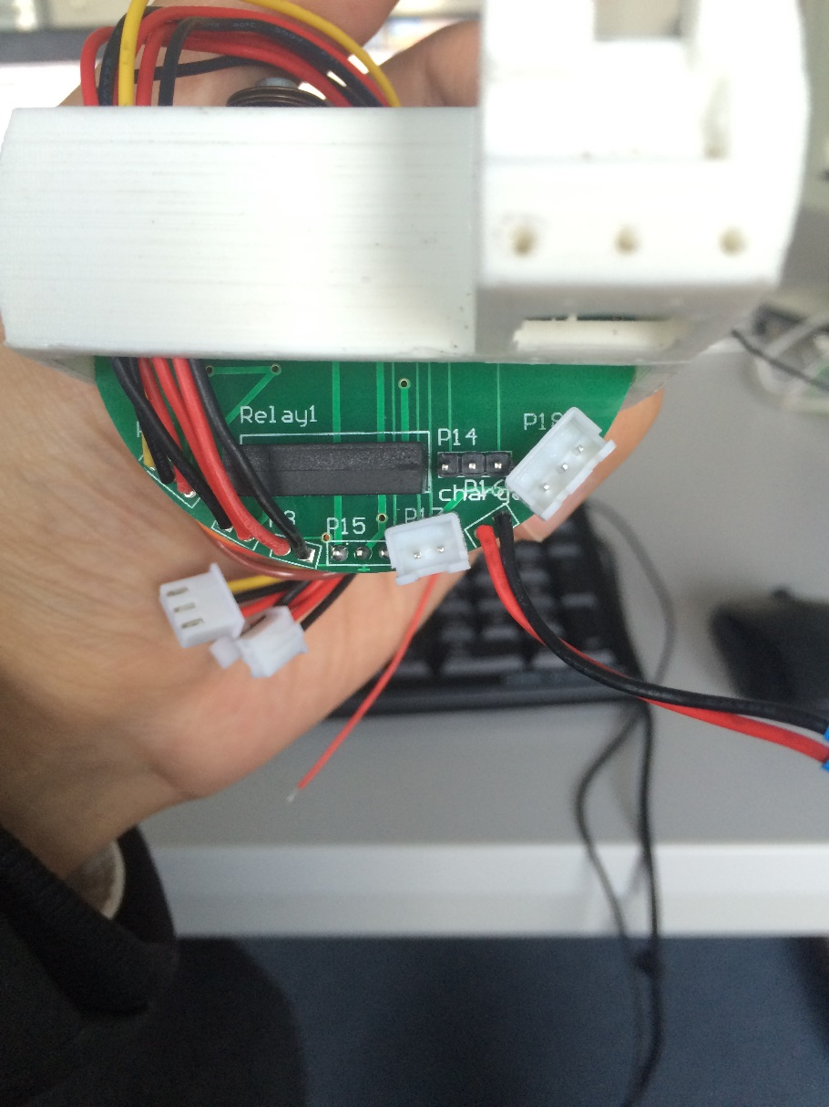
The PCB board
next_
charge
Switch
bus
Previous_charge
bus
switch
charge
Previous_charge
Notes:
OK, that is the roughly introduction of this lab course. Next, I will introduce snake robot to you in four aspects.
And then you can introduce yourself and tell us your strength, which part you are good at.

Slide 9
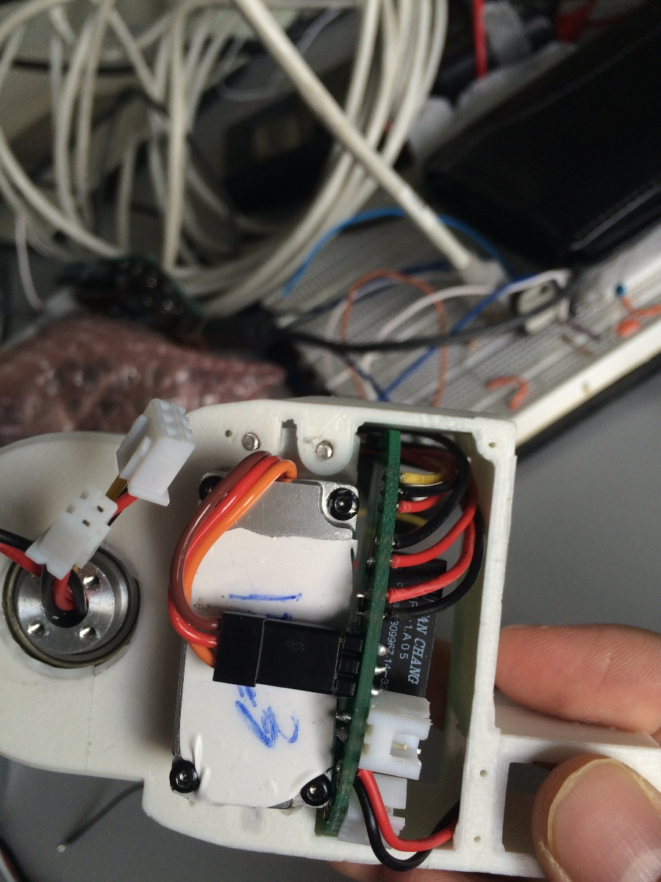
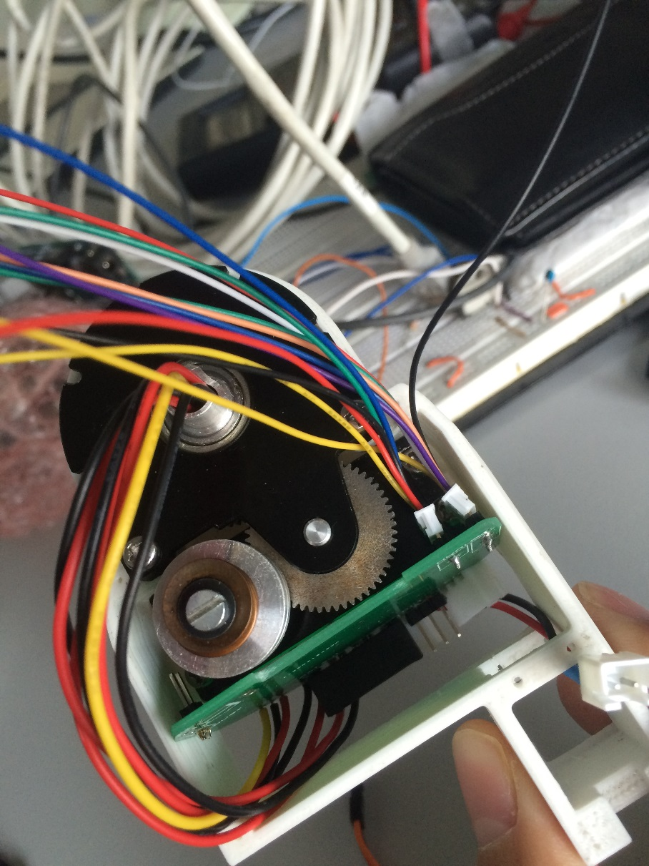
The PCB board

