Slide 1
Communication—the lab course of Snake Robot
Kai Huang, Long Cheng,
Zhenshan Bing, Mingchuan Zhou
Notes:
Guten Abend, everyone! My name is Zhenshan Bing. I know it is a little long for your to remember, you could just call me Bing. The same name as the Microsoft Search Engine
This afternoon I am going to introduce you guys with some principle about Servo Control by Arduino Nano board.
During this course, if you have any questions about the slides or my speaking language, do not hesitate to ask.
OK, Let us begin.

Slide 2


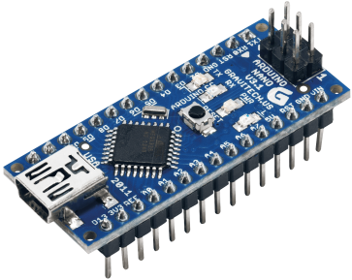

Background
Communication Design in Our Snake Robot
UART
Computer
Master
I²C
Slave_1
Slave_4
[Speed, CurrentAngle, TargetAngle]
Slave_2
Slave_3
Notes:
First of all, I am going to give you an quadruped spider as an example. In this short video, the spider can stand, can walk, and it keeps make a distinguished noise “zzzzzz”.
Yes, that’s the sound of the servos, which are often seen in scientific movies and logo car and other kinds of robots.
The servo doesn’t circle around just like the other regular motor. It can be rotate to the specific angle you desired and stop accurately.
By using the servo, we can make the same robot like this. Actually, when I was in my sophomore year, I built a six leg spider using 18 servos, just like this.
Today we are going to explore how to control those servos.

Slide 3
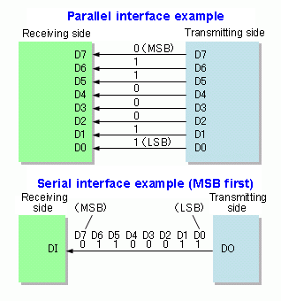

Background
Communication Overview
Parallel Communication
Serial Communication
Parallel Communication is used in PCI, ATA, et. al.
Serial Communication is used in Ethernet, USB, et. al.
What are the characteristics of both two kinds of communication methods?
Notes:
First of all, I am going to give you an quadruped spider as an example. In this short video, the spider can stand, can walk, and it keeps make a distinguished noise “zzzzzz”.
Yes, that’s the sound of the servos, which are often seen in scientific movies and logo car and other kinds of robots.
The servo doesn’t circle around just like the other regular motor. It can be rotate to the specific angle you desired and stop accurately.
By using the servo, we can make the same robot like this. Actually, when I was in my sophomore year, I built a six leg spider using 18 servos, just like this.
Today we are going to explore how to control those servos.

Slide 4
Background
Serial Communication
Asynchronous Serial Communication
Asynchronous serial communication is a form of serial communication in which the communicating endpoints' interfaces are not continuously synchronized by a common clock signal.
Synchronous Serial Communication
Synchronous serial communication describes a serial communication protocol in which data is sent in a continuous stream at a constant rate.
Notes:
First of all, I am going to give you an quadruped spider as an example. In this short video, the spider can stand, can walk, and it keeps make a distinguished noise “zzzzzz”.
Yes, that’s the sound of the servos, which are often seen in scientific movies and logo car and other kinds of robots.
The servo doesn’t circle around just like the other regular motor. It can be rotate to the specific angle you desired and stop accurately.
By using the servo, we can make the same robot like this. Actually, when I was in my sophomore year, I built a six leg spider using 18 servos, just like this.
Today we are going to explore how to control those servos.

Slide 5
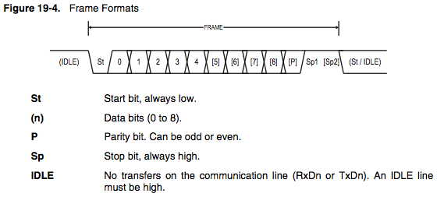
Background
Asynchronous Serial Communication——UART
UART, for Universal Asynchronous Receiver Transmitter, is one of the most used serial protocols.
Baud rate = 1/t
MCU1
MCU2
t
TX
RX
RX
TX
GND
GND
The Typically UART Timing Diagram and Electronic Connection
Notes:
First of all, I am going to give you an quadruped spider as an example. In this short video, the spider can stand, can walk, and it keeps make a distinguished noise “zzzzzz”.
Yes, that’s the sound of the servos, which are often seen in scientific movies and logo car and other kinds of robots.
The servo doesn’t circle around just like the other regular motor. It can be rotate to the specific angle you desired and stop accurately.
By using the servo, we can make the same robot like this. Actually, when I was in my sophomore year, I built a six leg spider using 18 servos, just like this.
Today we are going to explore how to control those servos.

Slide 6
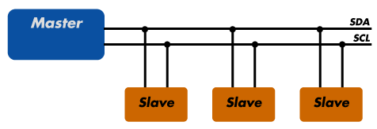
Background
Synchronous Serial Communication——I²C
Philips Semiconductors developed the I²C bus over 20 years ago and has an extensive collection of specific use and general purpose devices.
The Typically Electronic Connection
Notes:
First of all, I am going to give you an quadruped spider as an example. In this short video, the spider can stand, can walk, and it keeps make a distinguished noise “zzzzzz”.
Yes, that’s the sound of the servos, which are often seen in scientific movies and logo car and other kinds of robots.
The servo doesn’t circle around just like the other regular motor. It can be rotate to the specific angle you desired and stop accurately.
By using the servo, we can make the same robot like this. Actually, when I was in my sophomore year, I built a six leg spider using 18 servos, just like this.
Today we are going to explore how to control those servos.

Slide 7
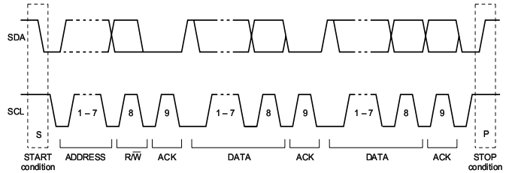
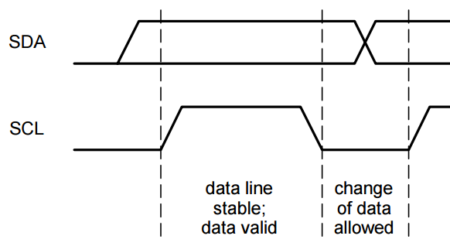
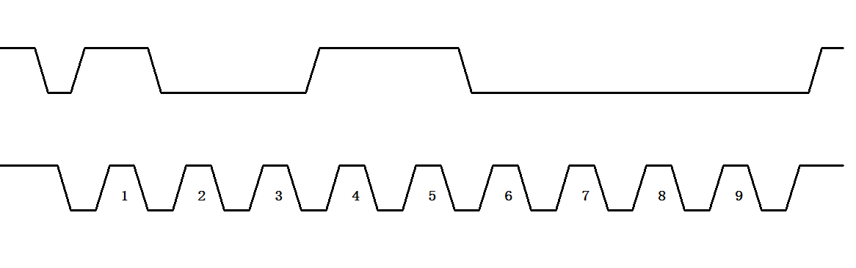
Background
Synchronous Serial Communication——I²C
The Typically I²C Timing Diagram
SDA
SCL
What message is this timing diagram transferring?
Notes:
This is typically I2C Protocols, including how the master start the communication, sending data and stop the communication.
It is obviously that when the bus is free, the SDA and SCL are both stay high.
Data Transfer is initiated with a START bit (S) signaled by SDA being pulled low while SCL stays high. This is controlled by Master.
Then we start to locate the address of the slave on the bus. Usually, it has 7bit address at most. The last bit is the Read or Write marker. If the SDA is pulled to high, the master will read data from the salve. If the SDA is pulled to low, it means that the master will write data to the salve. If there is a slave and this slave have the same address which the master is looking for, the SDA will be pulled to low. This is the ACK part. the small figure on the right side shows how the data can be recognized. The next is Data part and every part is followed by a ACK. The last part is the Stop.
It is a little complicated. I sorry that it would be more complicated in real application. Because the I2C can support multi-master in one bus, and the conflict detection will be introduced. If want learn more about you Google it by yourself.

Slide 8
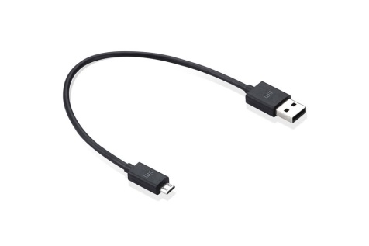
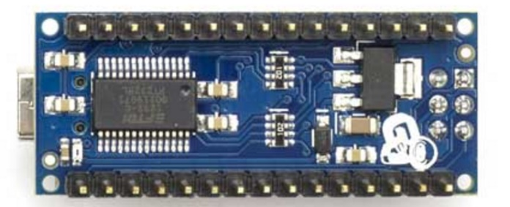
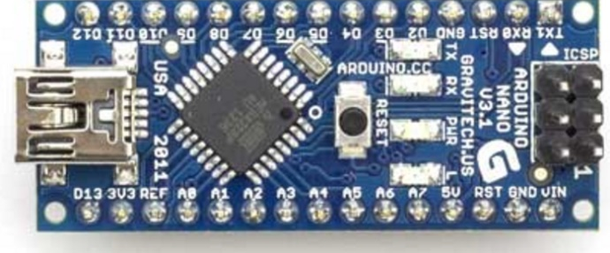
Background
How do communication work on the Arduino Nano
Computer
USB to serial chip CH340
SDA(A4)
SCL(A5)
5V
USB Cable
GND
Master Board
Slave Board
Learn more: https://www.arduino.cc/en/uploads/Main/ArduinoNanoManual23.pdf
Notes:
First of all, I am going to give you an quadruped spider as an example. In this short video, the spider can stand, can walk, and it keeps make a distinguished noise “zzzzzz”.
Yes, that’s the sound of the servos, which are often seen in scientific movies and logo car and other kinds of robots.
The servo doesn’t circle around just like the other regular motor. It can be rotate to the specific angle you desired and stop accurately.
By using the servo, we can make the same robot like this. Actually, when I was in my sophomore year, I built a six leg spider using 18 servos, just like this.
Today we are going to explore how to control those servos.

Slide 9
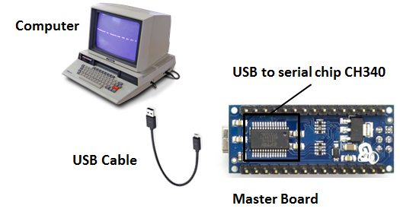
Practice One
Communication between Arduino Nano and Computer via UART
Start
Add Char to InputString
Configure Serial and
Initialization
If Char==‘/n’
Serial Interrupt Enable
StringComplete=1
StringComplete==1
Print InputString to Computer
Return Interrupt
Get string from computer and send it back to computer
Notes:
First of all, I am going to give you an quadruped spider as an example. In this short video, the spider can stand, can walk, and it keeps make a distinguished noise “zzzzzz”.
Yes, that’s the sound of the servos, which are often seen in scientific movies and logo car and other kinds of robots.
The servo doesn’t circle around just like the other regular motor. It can be rotate to the specific angle you desired and stop accurately.
By using the servo, we can make the same robot like this. Actually, when I was in my sophomore year, I built a six leg spider using 18 servos, just like this.
Today we are going to explore how to control those servos.

Slide 10
Practice One
Communication between Arduino Nano and Computer via UART
String inputString = ""; // a string to hold incoming data
boolean stringComplete = false; // whether the string is complete
void setup() {
Serial.begin(9600); // initialize serial:
inputString.reserve(200); // reserve 200 bytes for the inputString:
}
void loop() {
serialEvent(); //call the function
// print the string when a newline arrives:
if (stringComplete) {
Serial.println(inputString); // clear the string:
inputString = "";
stringComplete = false;
}
}
Learn more: https://www.arduino.cc/en/Tutorial/HomePage
Notes:
First of all, I am going to give you an quadruped spider as an example. In this short video, the spider can stand, can walk, and it keeps make a distinguished noise “zzzzzz”.
Yes, that’s the sound of the servos, which are often seen in scientific movies and logo car and other kinds of robots.
The servo doesn’t circle around just like the other regular motor. It can be rotate to the specific angle you desired and stop accurately.
By using the servo, we can make the same robot like this. Actually, when I was in my sophomore year, I built a six leg spider using 18 servos, just like this.
Today we are going to explore how to control those servos.

Slide 11
Practice One
Communication between Arduino Nano and Computer via UART
void serialEvent() {
while (Serial.available()) {
// get the new byte:
char inChar = (char)Serial.read();
// add it to the inputString:
inputString += inChar;
// if the incoming character is a newline, set a flag
// so the main loop can do something about it:
if (inChar == '\n') {
stringComplete = true;
}
}
}
Learn more: https://www.arduino.cc/en/Tutorial/HomePage
Notes:
First of all, I am going to give you an quadruped spider as an example. In this short video, the spider can stand, can walk, and it keeps make a distinguished noise “zzzzzz”.
Yes, that’s the sound of the servos, which are often seen in scientific movies and logo car and other kinds of robots.
The servo doesn’t circle around just like the other regular motor. It can be rotate to the specific angle you desired and stop accurately.
By using the servo, we can make the same robot like this. Actually, when I was in my sophomore year, I built a six leg spider using 18 servos, just like this.
Today we are going to explore how to control those servos.

Slide 12
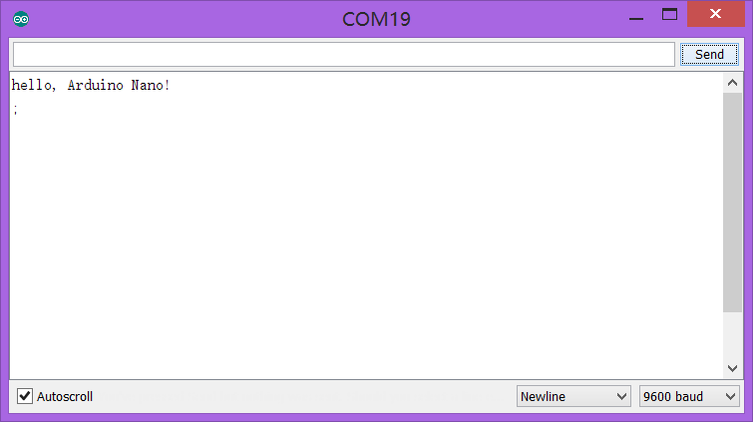
Practice One
Communication between Arduino Nano and Computer via UART
Learn more: https://www.arduino.cc/en/Tutorial/HomePage
Notes:
First of all, I am going to give you an quadruped spider as an example. In this short video, the spider can stand, can walk, and it keeps make a distinguished noise “zzzzzz”.
Yes, that’s the sound of the servos, which are often seen in scientific movies and logo car and other kinds of robots.
The servo doesn’t circle around just like the other regular motor. It can be rotate to the specific angle you desired and stop accurately.
By using the servo, we can make the same robot like this. Actually, when I was in my sophomore year, I built a six leg spider using 18 servos, just like this.
Today we are going to explore how to control those servos.

Slide 13
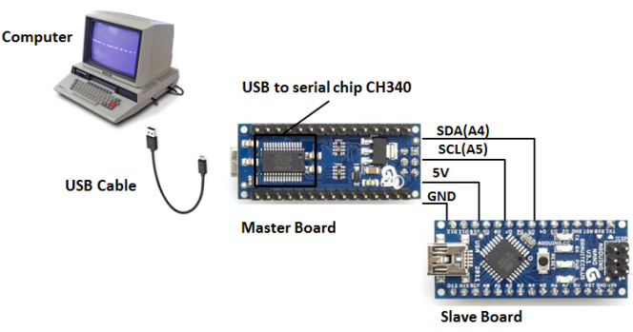

Practice Two
Communication between Arduino Nanos via I²C
Request Current Angle Data from the slave (every salve has a angle data for each joint) __Code for master
#include <Wire.h>
void setup() {
Wire.begin(); // join i2c bus (address optional for master)
Serial.begin(9600); // start serial for output
}
void loop() {
Wire.requestFrom(8, 1); // request 1 bytes（current angle） from slave device #8
while (Wire.available()) { // slave may send less than requested
byte c = Wire.read(); // receive a byte as character
Serial.println(c); // print the character
}
delay(500);
}
NOTE：
The addresses from 0 to 7 are not used because are reserved so the first address that can be used is 8.
Notes:
Okay, let’s see what make up a servo. Usually a servo is made up by those components in the slide.
A DC motor can provide the locomotion, reducer gears can slow down the speed and increase the torque. You know the power formula, Force times speed equals Power.
In this occasion, Torque times rotation speed equals power. So we can increase the torque by slowing down the speed.
A potentiometer can feed back the real angle position and a control circuit to accomplish the control function.
Servo shells and helm are obvious to hold all the components.

Slide 14
Practice Two
Communication between Arduino Nanos via I²C
Request Current Angle Data from the slave (every salve has a angle data for each joint)___code for slave
#include <Wire.h>
byte buf[3] = {12,10,18}; //speed, current angle, target angle
byte adrress = 8;
void setup() {
Wire.begin(adrress); // join i2c bus with address #8
Wire.onRequest(requestEvent); // register event
}
void loop() {
delay(100);
}
// function that executes whenever data is requested by master
// this function is registered as an event, see setup()
void requestEvent() {
Wire.write(buf[2]); // respond with message of 6 bytes// as expected by master
}
Notes:
Okay, let’s see what make up a servo. Usually a servo is made up by those components in the slide.
A DC motor can provide the locomotion, reducer gears can slow down the speed and increase the torque. You know the power formula, Force times speed equals Power.
In this occasion, Torque times rotation speed equals power. So we can increase the torque by slowing down the speed.
A potentiometer can feed back the real angle position and a control circuit to accomplish the control function.
Servo shells and helm are obvious to hold all the components.

Slide 15

Your Practice
Add as many slaves as you can to the I²C bus and send the angle data in each slave to the computer
Change the direction and speed of the rotation of the servo connected with the slave via UART
Tips:
DXXSXXAXXXDXXSXXAXXX….message send from computer with an endline marker
Change the String to number based on ASCII
Using for(int I = 0; i < count; i++) to analysis the commandline
Recommend D9 as your motor driving pin
Learn more about how to write data to slave : https://www.arduino.cc/en/Reference/Wire

