Slide 1
Praktikum WS2014: Hardware/Software Co-Design with a LEGO car
Kai Huang, Gang Chen, Hardik Shah, Long Cheng, Biao Hu

Slide 2
Goal
Hands-on embedded systems design
  Embedded software
  Embedded hardware
  System integration
Fun!

Slide 3
Organization
Group work
5 people per group
One car per group
One subject per group
Presentations
  Mid-term presentation
  Final presentation at the last week

Slide 4
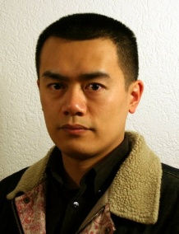

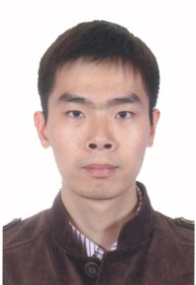
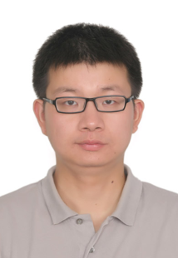
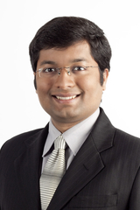
Team Introduction
Big team of PhD students and a senior researcher.

Slide 5
Topics
Marker following group
  Integration of marker following and Car2X work from previous semester
3 team competition on path following
  Identify a marker laying on the ground and follow the path to win in minimum time

Slide 6
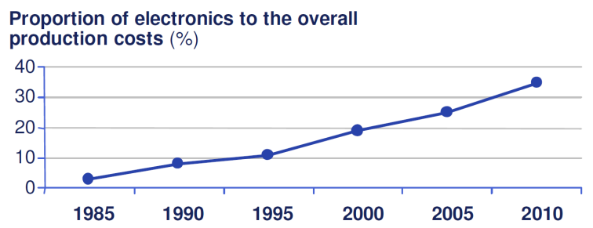
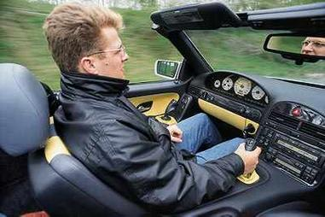
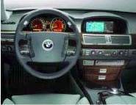
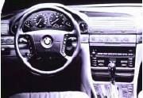
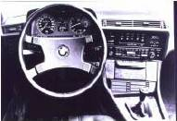
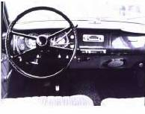
Marker following group: Background
Source: market and technology study automotive power electronics 2015
You name it !
ACC Stop&Go
BFD, ALC, KSG
42 voltage
Internet Portal
GPRS, UMTS
Telematics
Online Services
BlueTooth
Car Office
Local Hazard Warning
Integrated Safety System
Steer/Brake-By-Wire
I-Drive
Lane Keeping Assist.
Personalization
Software Update
Force Feedback Pedal…
Navigation System
CD-Changer
ACC Adaptive Cruise Control
Airbags
DSC Dynamic Stability Control
Adaptive Gear Control
Xenon Light
BMW Assist
RDS/TMC
Speech Recognition
Emergency Call…
Level of dependency
Electronic Gear Control
Electronic Air Condition
ASC Anti Slip Control
ABS
Telephone
Seat Heating Control
Autom. Mirror Dimming
…
Electronic Injections
Check Control
Speed Control
Central Locking …
1970
1980
1990
2000
2020
source: BMW
Notes:
Automotive industry
40% of the vehicle’s costs and 90% of new innovation related to software or electronics
100-fold increase of code lines in two decades
Software for monitoring and controlling car state, media players, database programs etc.

Slide 7
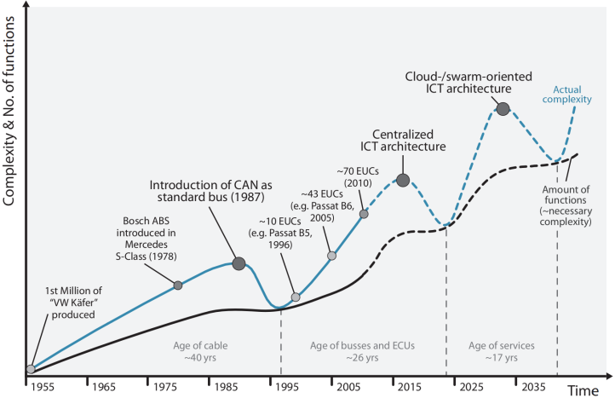
Marker following group: Background
ECUs
ECUs
C. Buckl, A. Camek, G. Kainz, C. Simon, L. Mercep, H. Stähle, A. Knoll. The Software Car: Building ICT Architectures for Future Electric Vehicles. 2012 IEEE International Electric Vehicle Conference, Greenville USA, March 2012
ECUs

Slide 8
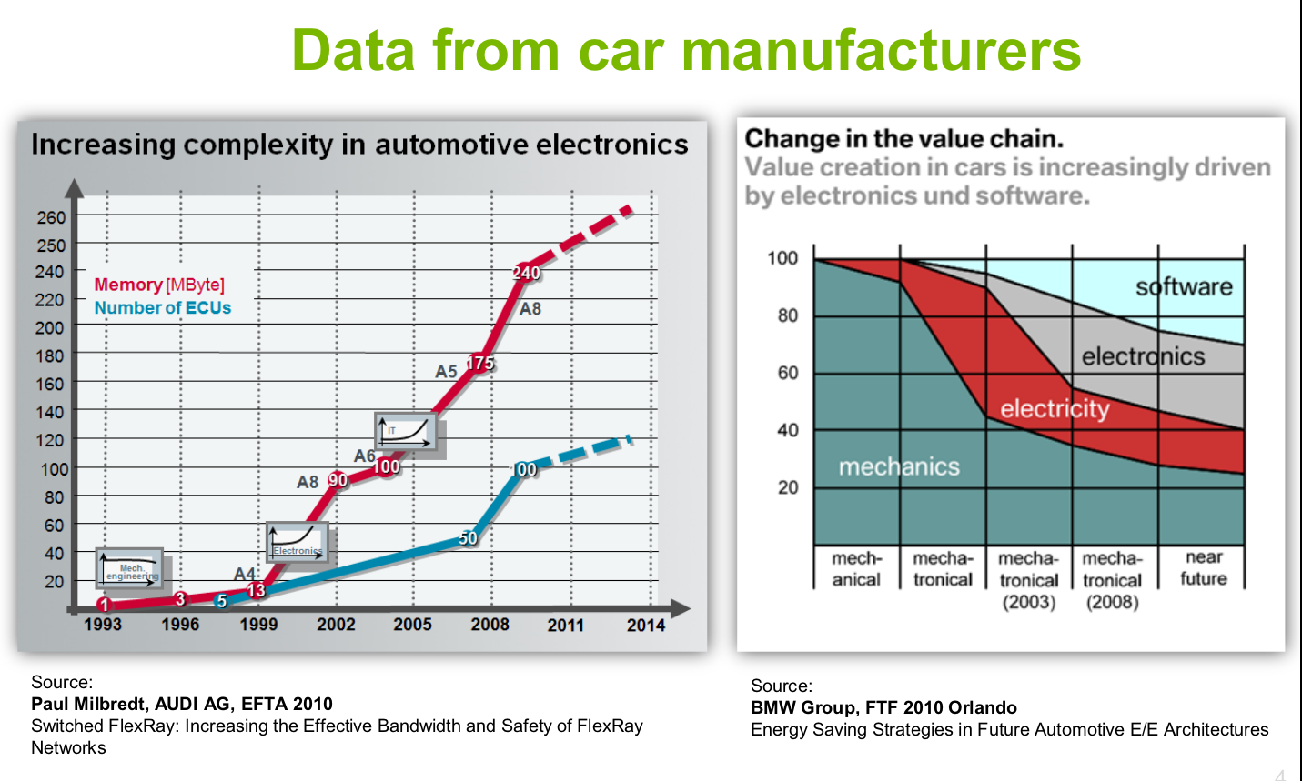
Marker following group: Background
Value Chain: Mechanics -> Embedded Systems
Notes:
Tier-1

Slide 9
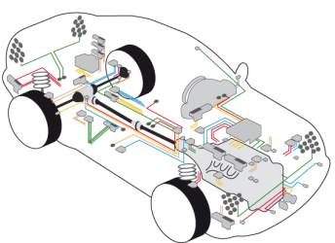
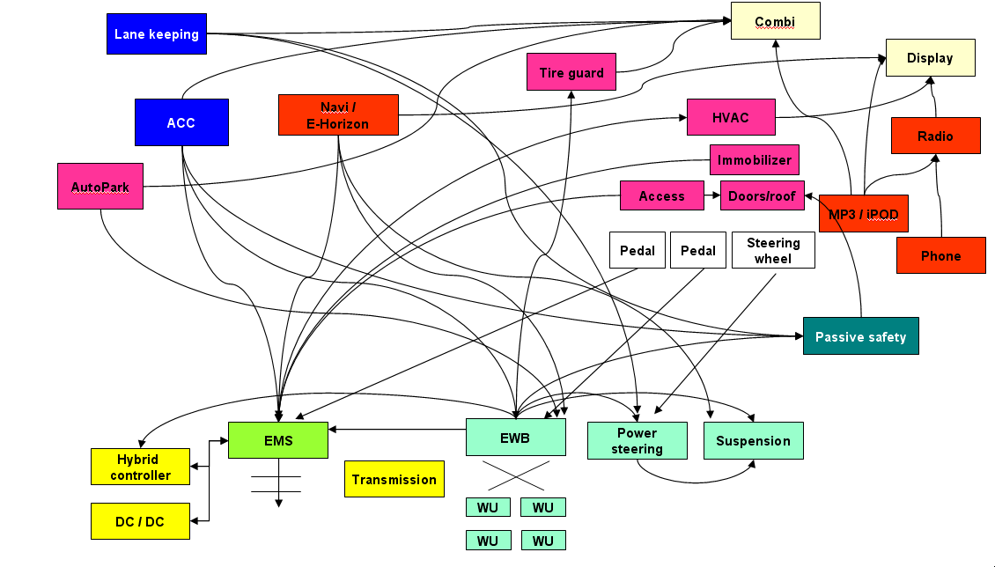
Marker following group: Background
Example: automatic engine start-stop systems
  Affects ~30 ECUs , functions spread across ECUs
  High complexity of communication and design processes
Data dependencies between all components; Functions are spread across ECUs
(G. Spiegelberg, Siemens AG)

Slide 10
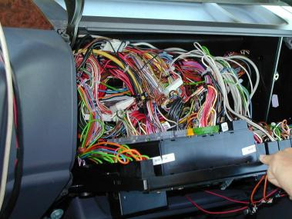
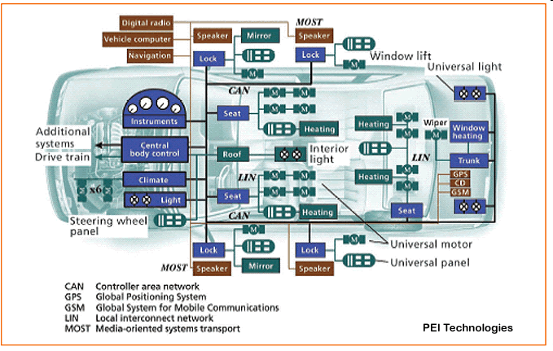
Marker following group: Background
“Hard wired” architectures with distributed ECUs
Dedicated bus systems with different transport parameters and service qualities

Slide 11
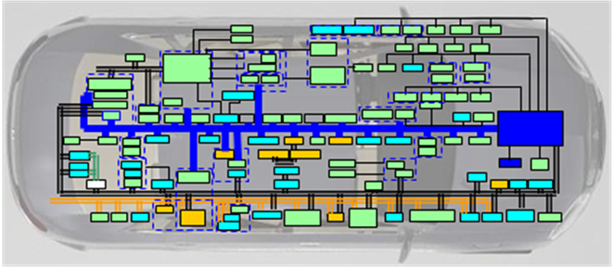
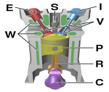
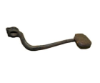

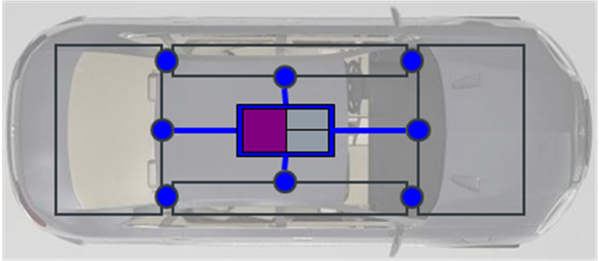



Marker following group: Background
State-of-the-art automobiles have about 70 (partly over 100) ECUs, with
limits reached in
Weight
Space (size of car)
Cost
Cables and connectors
Possible solution: car ICT structure using 5 to10 highly re-centralized and integrated ECUs
SC
SC
SC
Engine
Chassis
Entertainment
MC

Slide 12
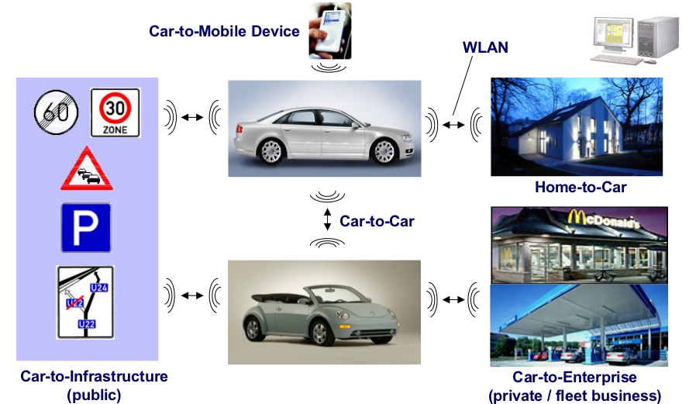
Marker following group: Background

Slide 13
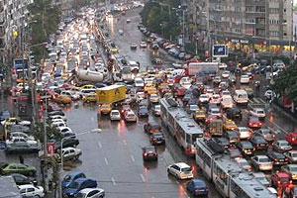
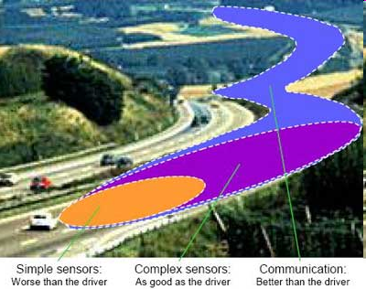
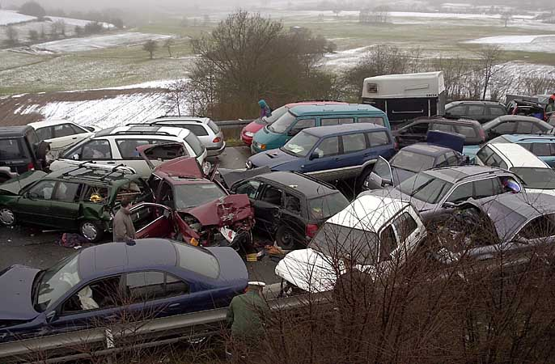
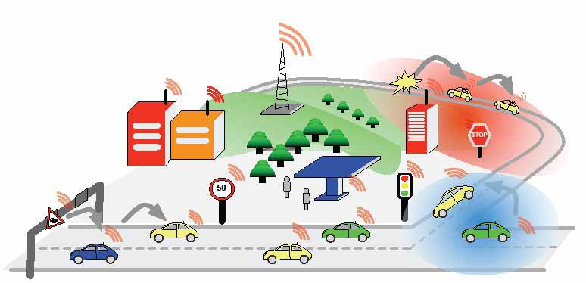
Marker following group: Background
Higher vehicle safety
Traffic management & optimization
Infotainment &
Value-added services
Vehicular Ad Hoc NETwork (VANET)
Latency requirements
Throughput and performance
Situation adaptiveness
13.10.2014
Notes:
In recent years great efforts have been made to improve traffic safety and efficiency and especially in passive and more recently in active safety great achievments have been made (ESP, airbags, precrash measurements, active breaking…)
But active safety measures rely on the availability of environmental and traffic data to vehicles.
On-board sensors are restricted in range (line of sight…)
-> Information exchange between vehicles, single and multi hop
→goal: enlargement of information horizon
Ziele:
→higher vehicle safety: collision warning, road condition information, electronic breaking light
→Traffic management: traffic jam warning, self organization, navigation systems
→reduction of fuel consumption: speed recommendations, Alternative routes
→Convenience / comfort: Location based services, route information, Infotainment

Slide 14
Topics
Centralized architecture on eCar
  High performance multi-core central ECU
  Communication with peripheral ECUs via Ethernet
  Car2X communication from the preceding car in emergency situations
Competition
  BeagleBone Black
  OpenCV
  ROS

Slide 15
Marker following group
Expertise
  High motivation
  C/C++, Basic FPGA (will be taught), Ethernet communication
  ROS, OpenCV are plus
  Challenging, high research value

Slide 16
Path following competition
Identify markers laying on the ground floor of our building using a downwards mounted camera
Follow the markers to reach the end point the fastest !
iMX6 board as a main computing platform
  DE0-nano board as slave to execute low level functionalities

